Slide 1

Industrial Graduate Program
5th edition

Slide 2
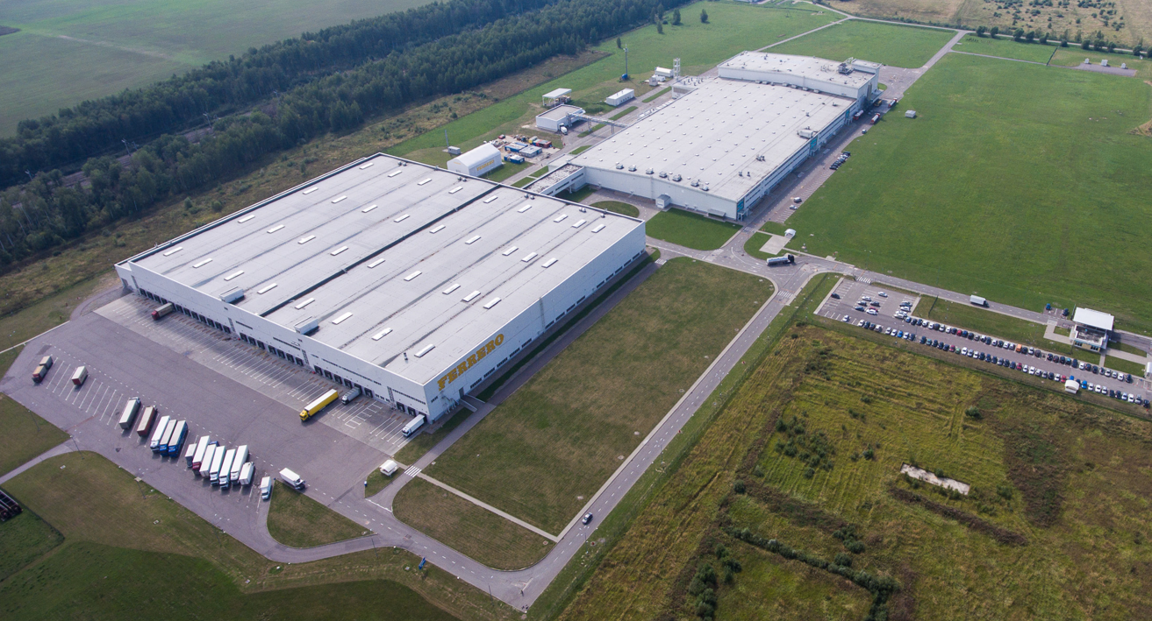
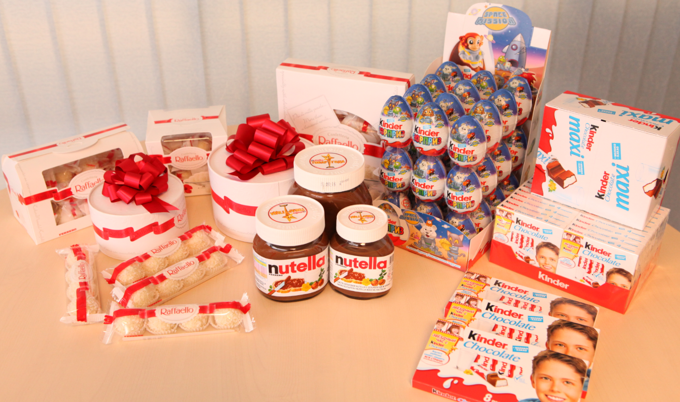
VLADIMIR plant
start up 2008
1500 working places
4 industrial lines
8 semi-automatic lines
37 average age of employee

Slide 3












PREVIOUS EDITIONS OVERVIEW
4th Edition
4 Editions general overview:
15 participants
8 different nationalities
Retention rate
first three editions: 75%
more than 30 Graduates, 12 different nationalities

Slide 4
APPLICANT PROFILE
Recruitment/ Profiles
  Academic Background: JUST GRADUATED in
    Food Technology, Production Engineering
  International internships or education as a PLUS
  Lean Methodologies: knowledge considered as a PLUS
  Work experience: max 12 months of work experiences
  Language: Russian native, English as a MUST, other language as a PLUS
  Recruitment and Selection in 2 steps:
    1st: Local recruitment process; 2nd: SHL international assessments
Personality/ Motivation
  Your awareness about FERRERO people, product, values: do you share, are you going to stay with us? Please, send us an essay on the topic.
  International mobility: be flexible, ready for relocation abroad and back by company request, study languages.

Slide 5
PROGRAM STRUCTURE
PHASE I
PHASE II
12 m.
24 m.
ROLES
TECHNOLOGY ,
PRODUCTION ENGINEERING
TECHNOLOGY ,
PRODUCTION ENGINEERING
Induction
FINAL ROLE
to be defined
1st year:
Vladimir factory
2nd year:
Ferrero factory
other country
FERRERO GLOBAL GRADUATE PROGRAM
TUTORSHIP
FERRERO
UNIVERSITY
Training on hard + soft skills
Training on hard + soft skills

Slide 6
Thank You
Notes:
Add your contacts below for presentations to non-Ferrero audience

